Slide 1
딥러닝 원리 및 이론 배우기
09 – RNN

Slide 2
은닉층
입력층
출력층

Slide 3
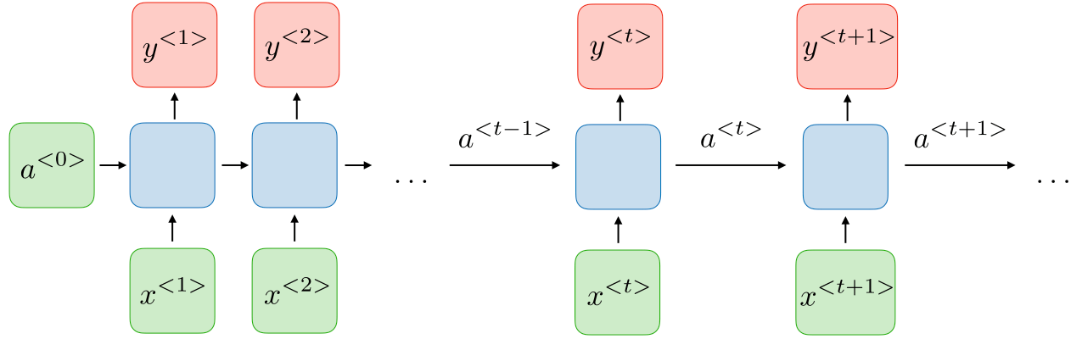
Hidden state
Vanishing
gradient
https://stanford.edu/~shervine/teaching/cs-230/cheatsheet-recurrent-neural-networks

Slide 4
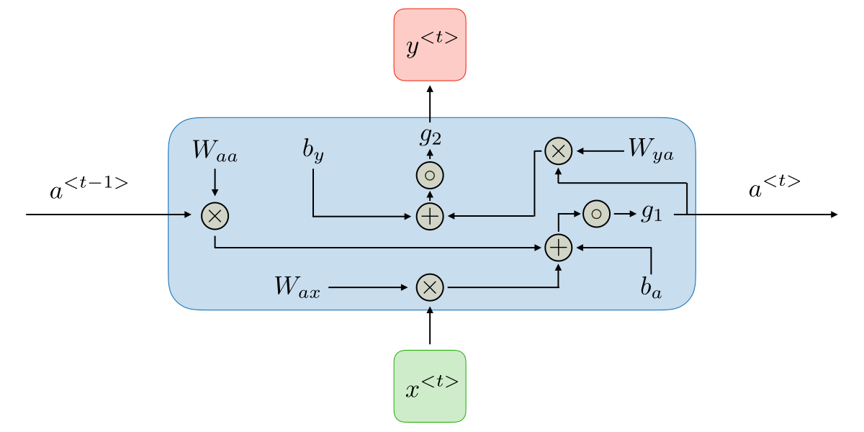
https://stanford.edu/~shervine/teaching/cs-230/cheatsheet-recurrent-neural-networks

